Slide 1
The Art & Science of Goal Meeting
Westchester Library Association Annual Conference
May 9, 2014
By: Erin Nichole, MAPP, CPC, RYT

Slide 3
Positive Psychology
-The science of optimal human functioning
-Build on what’ s right, not just fix what’s wrong
Martin Seligman

Slide 4
What are your goals?
-Think about what goals you’re currently striving to meet.
-For the next 5 minutes, discuss with a partner what those goals may be, how progressing towards them is going, and what difficulties you may have encountered in meeting them

Slide 5
Did you make a New Year’s Resolution in 2014?

Slide 6
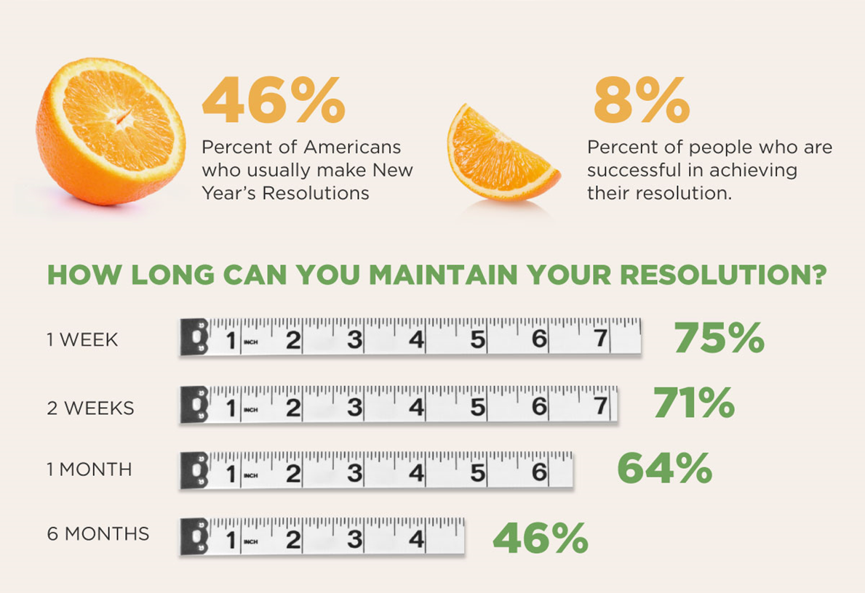
New Year’s Resolutions

Slide 7
Why do people fail to make the positive changes they want?
- Most failed goals were poorly designed in the first place, making a process problem seem like a person problem

Slide 8
Why do goals are set and not met:
-poorly defined or stated goal
-poor preparation/planning
-lack of vision and mapping
-lack of accountability
-lack of intrinsic motivation or inherent desire to meet goal
-lack of ‘will power’
-lack of primers or rituals to reinforce goals
-failure to plan to fail

Slide 9
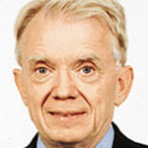
Pre-Goal Setting
-Get clear on what matters most
-The importance of a goal is one
of the most critical factors in
determining whether or not
it will be met
-connect daily micro-goals to core beliefs or macro-goals
Edwin Locke

Slide 10
Exercises for clarity
-Best Possible Self-Exercise (King, 2001)
-Wheel of Life
-Needs and Wants List
-Bucket List

Slide 11
SMART Goals
Specific: well defined, clear to everyone.
Measurable: concretely know when the goal is achieved or how far away from completion it is.
Agreed Upon: all the stakeholders agree what the goal should be. Or Attainable by the person
Realistic: within reach and attainable given skill, resources and time.
Timely: enough time to achieve the goal without hindering performance.

Slide 12
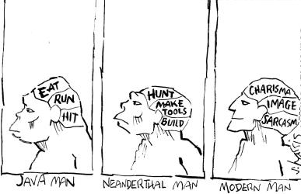
Evolutionary Perspectives

Slide 13
The Triune Brain (MacLean, 1960)

Slide 14
Rider and Elephant

Slide 15
Feed your Elephant
-Specific
-Break goal down into small action steps
-Measurable
-Let your elephant know it’s moving the right direction

Slide 16
Don’t think about a white elephant!

Slide 17
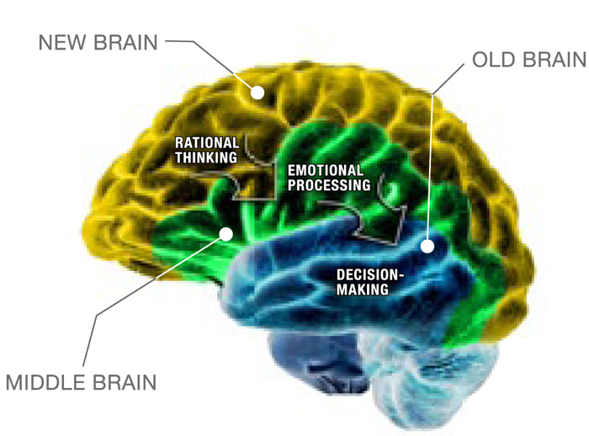
Approach vs Avoidance Goals

Slide 18
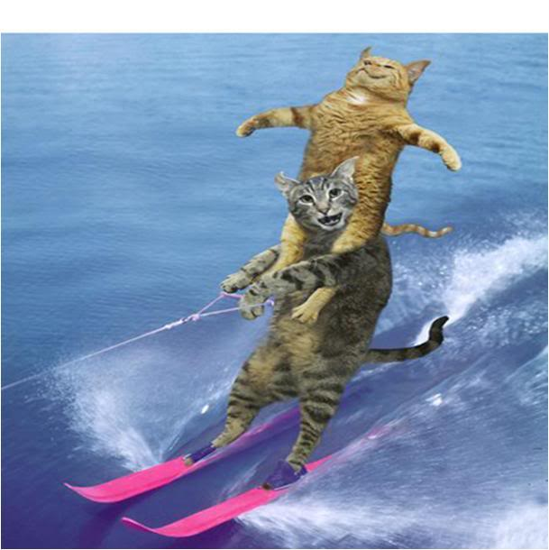
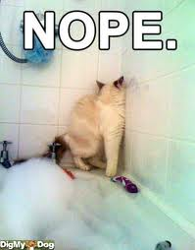
“Avoiding something takes more mental and physical energy than approaching it”
VS
(Adams-Miller & Fisch, 2009 p.4)

Slide 19
Manage your energy, not your time “..time is a finite resource. Energy is a different story. Defined in physics as the capacity to work, energy comes from four main wellsprings in human beings: the body, emotions, mind, and spirit” -Harvard Business Review

Slide 20
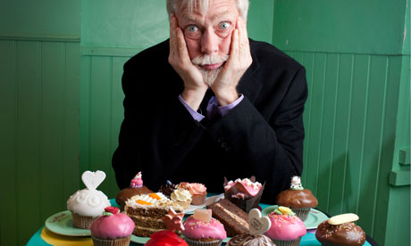
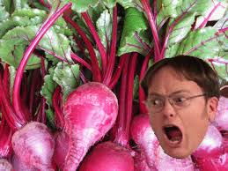
Ego Depletion
Roy Baumesiter

Slide 21
Self-regulation
Limited resource
Self-regulating in one area can deplete capacity to regulate in others (ego-depletion)
-Like a muscle, self-regulation can be built

Slide 22
FLOW
-intense and focused concentration on the present moment
-merging of action and awareness
-loss of reflection self-consciousness
-sense of personal control or agency over situation
-a distortion of temporal experience
-activity is intrinsically rewarding
Mihaly Csikszentmihalyi

Slide 24
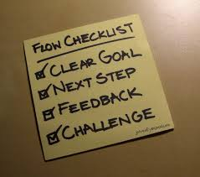
Conditions for Flow
Activity must have structure and direction (specific goals and measureable progress)
Clear and immediate feedback
Balance between perceived challenges of the task and own perceived skills

Slide 26
How can you create more flow in your life?

Slide 27
Managing Physical Energy
Inadequate nutrition, lack of exercise, sleep, and rest all diminish basic energy levels and ability to manage emotions and focus mental attention”
Listen to your ‘Ultradian rhythms’ : 90-120 minute cycles in which we move from a peaked energy state into a physiological trough
Body craves period of recovery: take genuine breaks for renewal

Slide 29
Managing Spiritual Energy: Meaning & Purpose
When goals are consistent with values, it provides a sense of purpose
Working towards something meaningful helps people “feel more positive energy, focus better, and demonstrate greater perseverance”
Create rituals in service of values

Slide 31
Questions? Turn to partner and discuss how you could use something you’ve learned this morning to help you meet your goals

Slide 32
THANK YOU!!
What man actually needs is not a tensionless state, but rather the striving and struggling for some goal worthy of him. What he needs is not the discharge of tension at any cost, but the call of a potential meaning waiting to be fulfilled by him.
– Viktor Frankl
Erin Nichole, MAPP, CPC, RYT
erin@erin-nichole.com
(828) 238-5822

